Slide 1
Motion Estimation Using Optical Flow
Mahendra Basyal
Faculty – Dr. Yuchou Chang
Notes:
Before discussing project details , Lets just talk about motion estimation and optical flow.
Experience everyday as object infront of us move or we as a object move.
Obvious thing such as brightness changes, along with displacement.

Slide 2
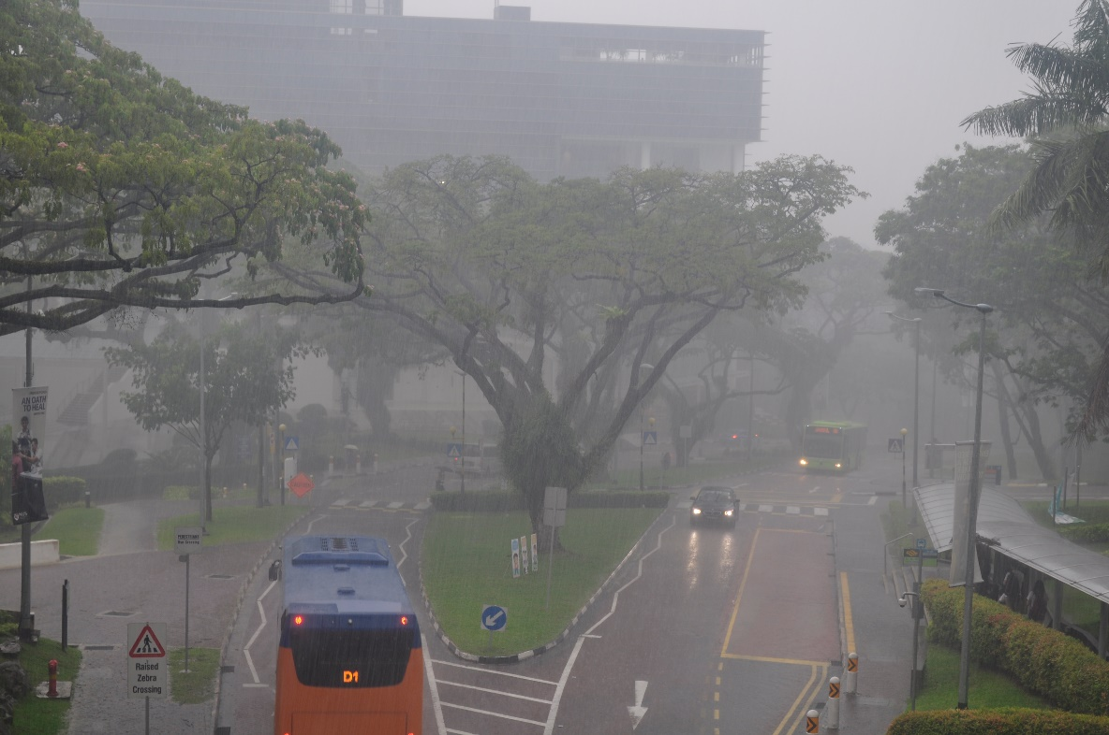
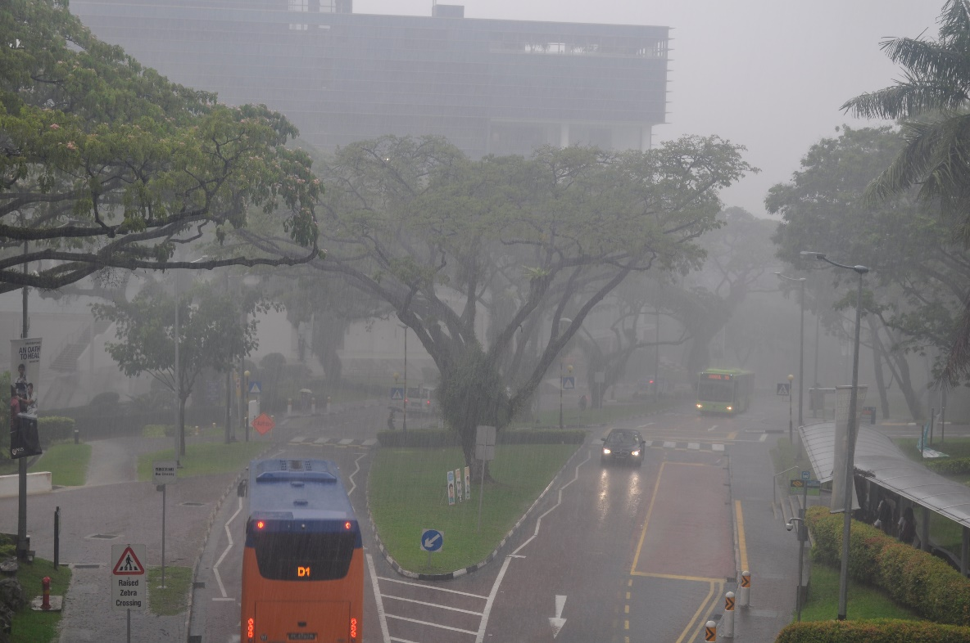
Motion Estimation Using Optical flow
Attempt to estimate 2D projection of 3D-real world motion.
Major applications are in field of Artificial Intelligence and Robotics.
Optical flow is used in digital cameras and video compression.
Notes:
It’s a machines attempt to estimate 2d projection of 3D-real world motion.
AI or Robots which use computer vision features use optical flow and motion estimation
Image stabilization cameras, medical imaging

Slide 3
Project Objective
Described in the project is a method for using combination of multiple optical flow models to enhance accuracy and efficiency while computing motion estimation. Horn and Schunck optical flow is used in the project to estimate motion using optical flow.
Horn and Schunck optical flow model has low accuracy, especially for images with complex texture and nonrigid motion.
Modification in energy function and brightness constraint is proposed in order to reflect Fractional-Order optical flow model.
Notes:
Non-rigid motion means size of the object increase of decrease. Doesn’t preserve the shape of objects.

Slide 4

OCTAVE 5.0.1
Released on March 2019.
Easier and Faster execution than previous model 4.4.1.
Preinstalled packages, users only need to load package.
No installation required, simply extract zip-file and run.

Slide 5
Project Layout
Horn and Schunck
Energy Function
Brightness Constraint
Fractional-Order
Energy Function
Modified Parameters
Euler Lagrange
Brightness Constraint
Median Filters
Reducing smoothness
Notes:
Previous study on image processing such as image segmentation.
Execute and implement horn and Schunk method. Then study energy function and brightness constraint
Fractional-Order was studied from a research article and its energy function and brightness constraint.
Last stage was to identify parameters which could be changed to enhance horn and schunck method.

Slide 6
Horn and Schunck
Berthold K.P. Horn and Brian G.Schunck, AI Laboratory, MIT 1981.
Optical flow cannot be computed locally, since only one independent measurement is available from the image sequence at a point, while flow velocity has two components.
Determine optical flow through minimization of global energy functional.
Modification in energy function and brightness constraint is proposed in order to reflect Fractional-Order optical flow model.
Notes:
Global methods have the ability to produce dense optical flow fields while doesn’t offer robustness to the noise.

Slide 7
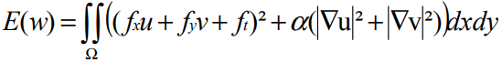
Energy Function
Horn and Schunck were the first to introduce global method, global constraint of smoothness over the computed flow field.
In the equation above fx denotes the partial derivative of f with respect to x, and u is the horizontal displacement with v being the vertical displacement.
|nabla u|^2 is equal to (ux^2 + uy^2)^(1/2)
If displacement between frames is small enough, the grey value will not drastically change from frame to frame.
Notes:
Two assumptions are made. Grey value constancy assumption and flow field smoothness assumption. Flow field trying to be computed should be globally smooth.
Fx and fy are found by calculating optical flow image based on differentiation method
Ft is based on distinguishing two image pixels.

Slide 8
Brightness Constraint Function
Brightness constraint relates the change in image brightness at a point to the motion of the brightness pattern.
Brightness at a particular point is dE/dt = zero.
(∂E/∂x) dx/dt + (∂E/∂y) dy/dt + (∂E/∂t) = 0. Let u = dx/dt and v = dy/dt, then we can see that we have a single linear equation in the two unknowns u and v, E_{x}u + E_{y}v + E_{t} = 0, we can go further and write the equation as (E_{x}, E_{y}) (u, v) = -E_{t.}
Image brightness at the point (x, y) and the image plane at time T be denoted by E (x, y, t).
Notes:
Using Chain rule for differentiation we see that
Partial sign - ∂ is partial derivative.

Slide 9
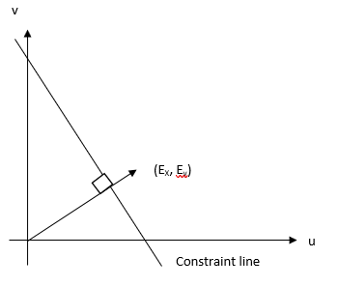
Brightness Constraint Function
The basic rate of change of image brightness equation constrains the optical flow velocity. The velocity (u, v) has to lie along a line perpendicular to the brightness gradient vector (Ex, Ey). The distance of this line from origin equals Et divided by the magnitude of (Ex, Ey).
Notes:
We cannot however determine component of the movement in the direction of the iso brightness contours, at the right angles to the brightness gradient. As a consequence the flow velocity (u, v) cannot ne computed locally.

Slide 10
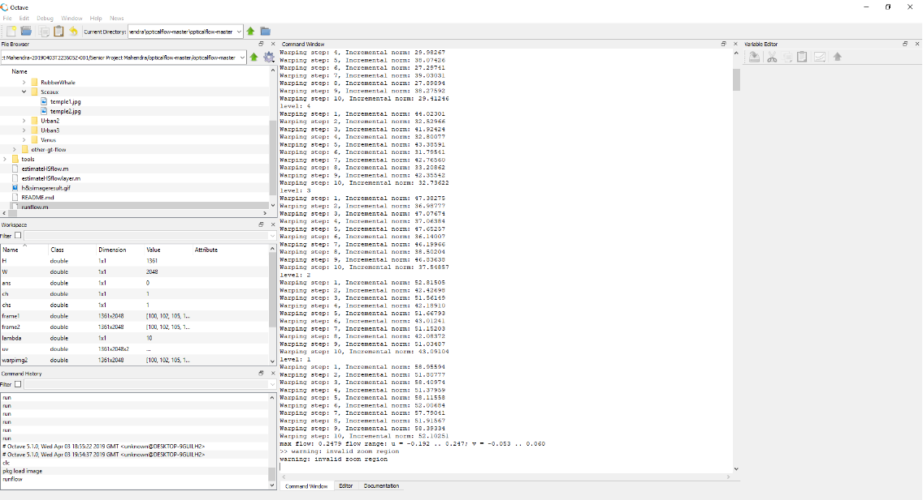

Slide 11
Fractional-Order
Fractional Order was first used in a brightness constraint equation of Horn and Schunck method in an attempt to preserve motion discontinuity.
Fractional-Order method uses many fractional derivatives and differential masks for overall higher performance compared to Horn and Schunck method.
Ability of preserving motion discontinuity, enhances results in image processing, such as image denoising, image enhancement and motion estimation.

Slide 12
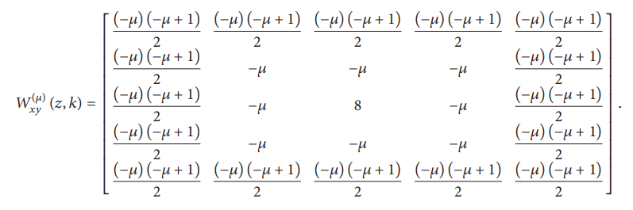
W_{xy}^{(µ)} (z, k) is defined as the two-dimensional fractional differential mask of dual derivatives on the x and y axis.
Notes:
Wxx, Wxy, Wxt, Wyy, Wyx, Wyt
We are taking mean or standard deviation of fractional differentials.
Fractional differential masks are used to minimize impulse noise.

Slide 13
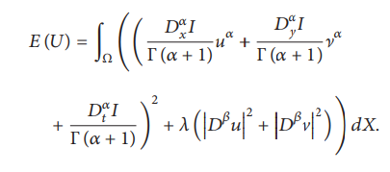
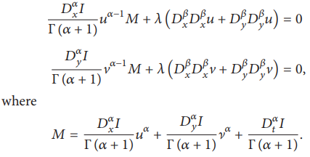
Energy Function
Euler Lagrange equation is used to minimize energy function. When the derivatives are of only integral order only, the results of fractional calculus of variations reduce to those obtained from classical calculus of variation.
When α = 1, the fractional-order variational optical flow model can be seen as the Horn and Schunck first order variational model. When α = 2 it can be seen as generalization of integer order variational optical flow model.
Notes:
Alpha and beta values were hard to unsderstand. The studied model argued that these values would change according to image texture, complex image having smaller alpha value . Beta value would change little in different image sequence.

Slide 14
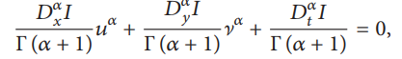
Brightness Constraint Function
Fractional-Order method uses the same brightness constraint equation of the Horn and Schunck methods with the addition of the fractional-order Taylor series expansion.

Slide 15

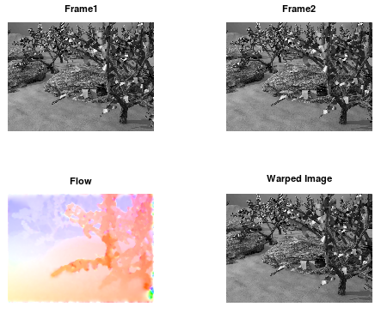
Horn and Schunck Result
Notes:
Idea was to modify horn and schunck to reflect the result in the end of those three images.

Slide 16
Modified Parameters
Euler Lagrange
Median Filters
Reducing Smoothing Effects

Slide 17
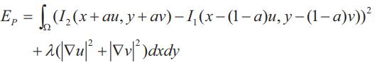
Euler Lagrange
In order to deal with noise and illumination changes in the real-world images, the fusion of two images gradient is used for computing Euler-Lagrange equations applying the variational method.
With smoothness assumption, the classical global variational model can be written as:
Since the scenes are continuous, there exist states between I1 and I2.
If a = 1 then it will be same as classical, so the value is set t0 0.5
Notes:
An image gradient is a directional change in the intensity or color in an image.

Slide 18
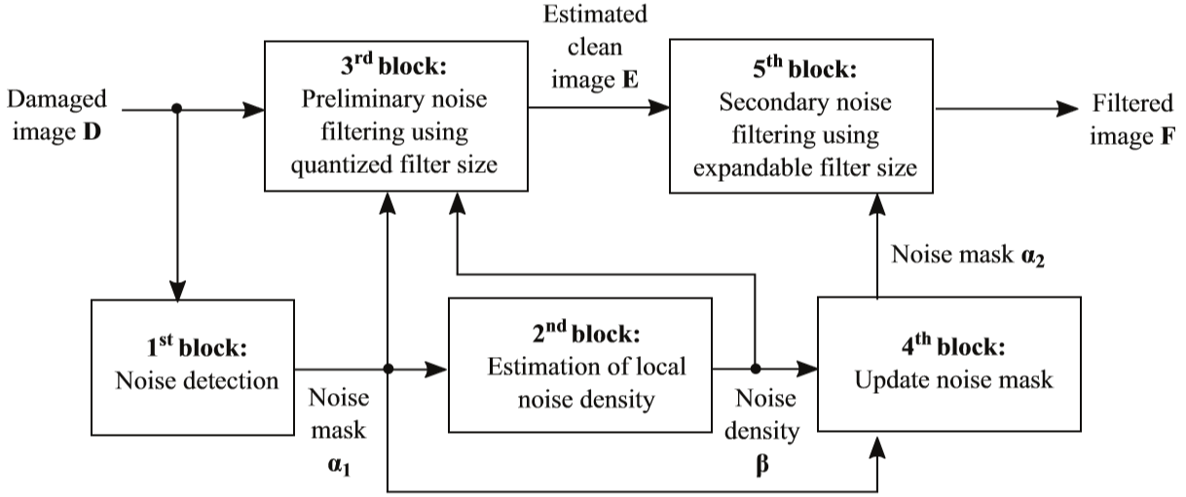
Median Filters
Impulse noise is one of the most common noise found in digital images.
Standard Median Filter (SMF) was introduced in 1971 by Tukey.
Notes:
This picture was generated from article studided.

Slide 19
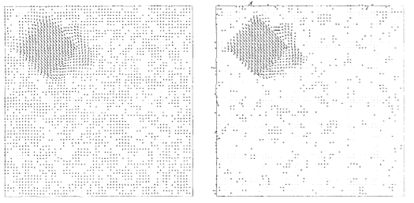
Reducing Smoothing Effects
A modification of the Horn and Schunck method can be obtaines by computing the means values of u and v and by the means of median filtering operation.

Slide 20
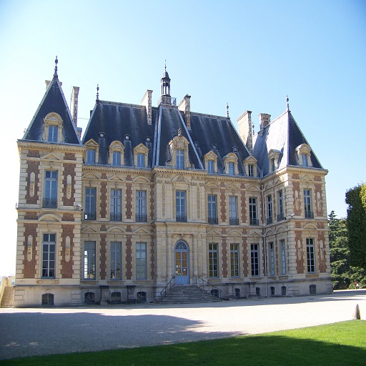
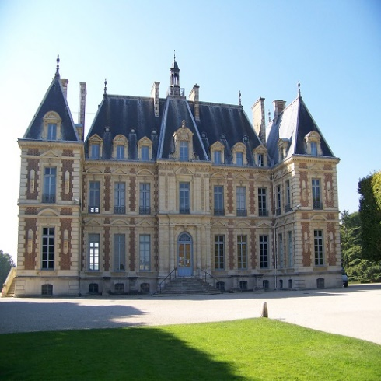
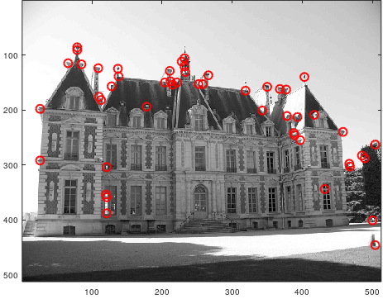
Corner Detection

Slide 21
Conclusion
Horn and Schunck method can be enhanced to reflect more accuracy and high level of performance through various modifications.
Using median filters, image impulse noise can be degraded for better edge detection while computing optical flow field.
Instead of converting fractional-order method, it is easier to add new features on existing Horn and Schunck method.
Due to the widespread use of Horn and Schunk method, it is more accessible to study numerous enhancement features.

Slide 22
References
[1] J. a/l Kanawathi, S. S. Mokri, N. Ibrahim, A. Hussain and M. M. Mustafa, "Motion detection using Horn Schunck algorithm and implementation," 2009 International Conference on Electrical Engineering and Informatics, Selangor, 2009, pp. 83-87.
[2] B. K. P. Horn and B. G. Schunck. Determining optical flow. Artificial Intelligence, 17:185–203, 1981.
[3] Bin Zhu, Lianfang Tian, Qiliang Du, Qiuxia Wu, and Lixin Shi, "An Improved Fractional-Order Optical Flow Model for Motion Estimation," Mathematical Problems in Engineering, vol. 2018, Article ID 6278719, 6 pages, 2018.
[4] Dali Chen, Hu Sheng, YangQuan Chen, & Dingyü Xue. (2013). "Fractional-order variational optical flow model for motion estimation." Philosophical Transactions of the Royal Society A: Mathematical, Physical & Engineering Sciences, 371(1990), 4
[5] J. Xu, Z. Feng and N. Lu, "Optical flow estimation with parameterized data term and warping," Proceedings of the 10th World Congress on Intelligent Control and Automation, Beijing, 2012, pp. 4633-4637.
[6] IBRAHIM, H., & ABDALAMEER, A. K. (2019). "Improvement of quantized adaptive switching median filter for impulse noise reduction in gray-scale digital images." Turkish Journal of Electrical Engineering & Computer Sciences, 27(1), 580–594.
[7] F. Bartolini and A. Piva, "Enhancement of the Horn and Schunck optic flow algorithm by means of median filters," Proceedings of 13th International Conference on Digital Signal Processing, Santorini, Greece, 1997, pp. 503-506 vol.2.

Slide 23

Questions?

